Slide 1
DevOps Workshop, Part I

Slide 2
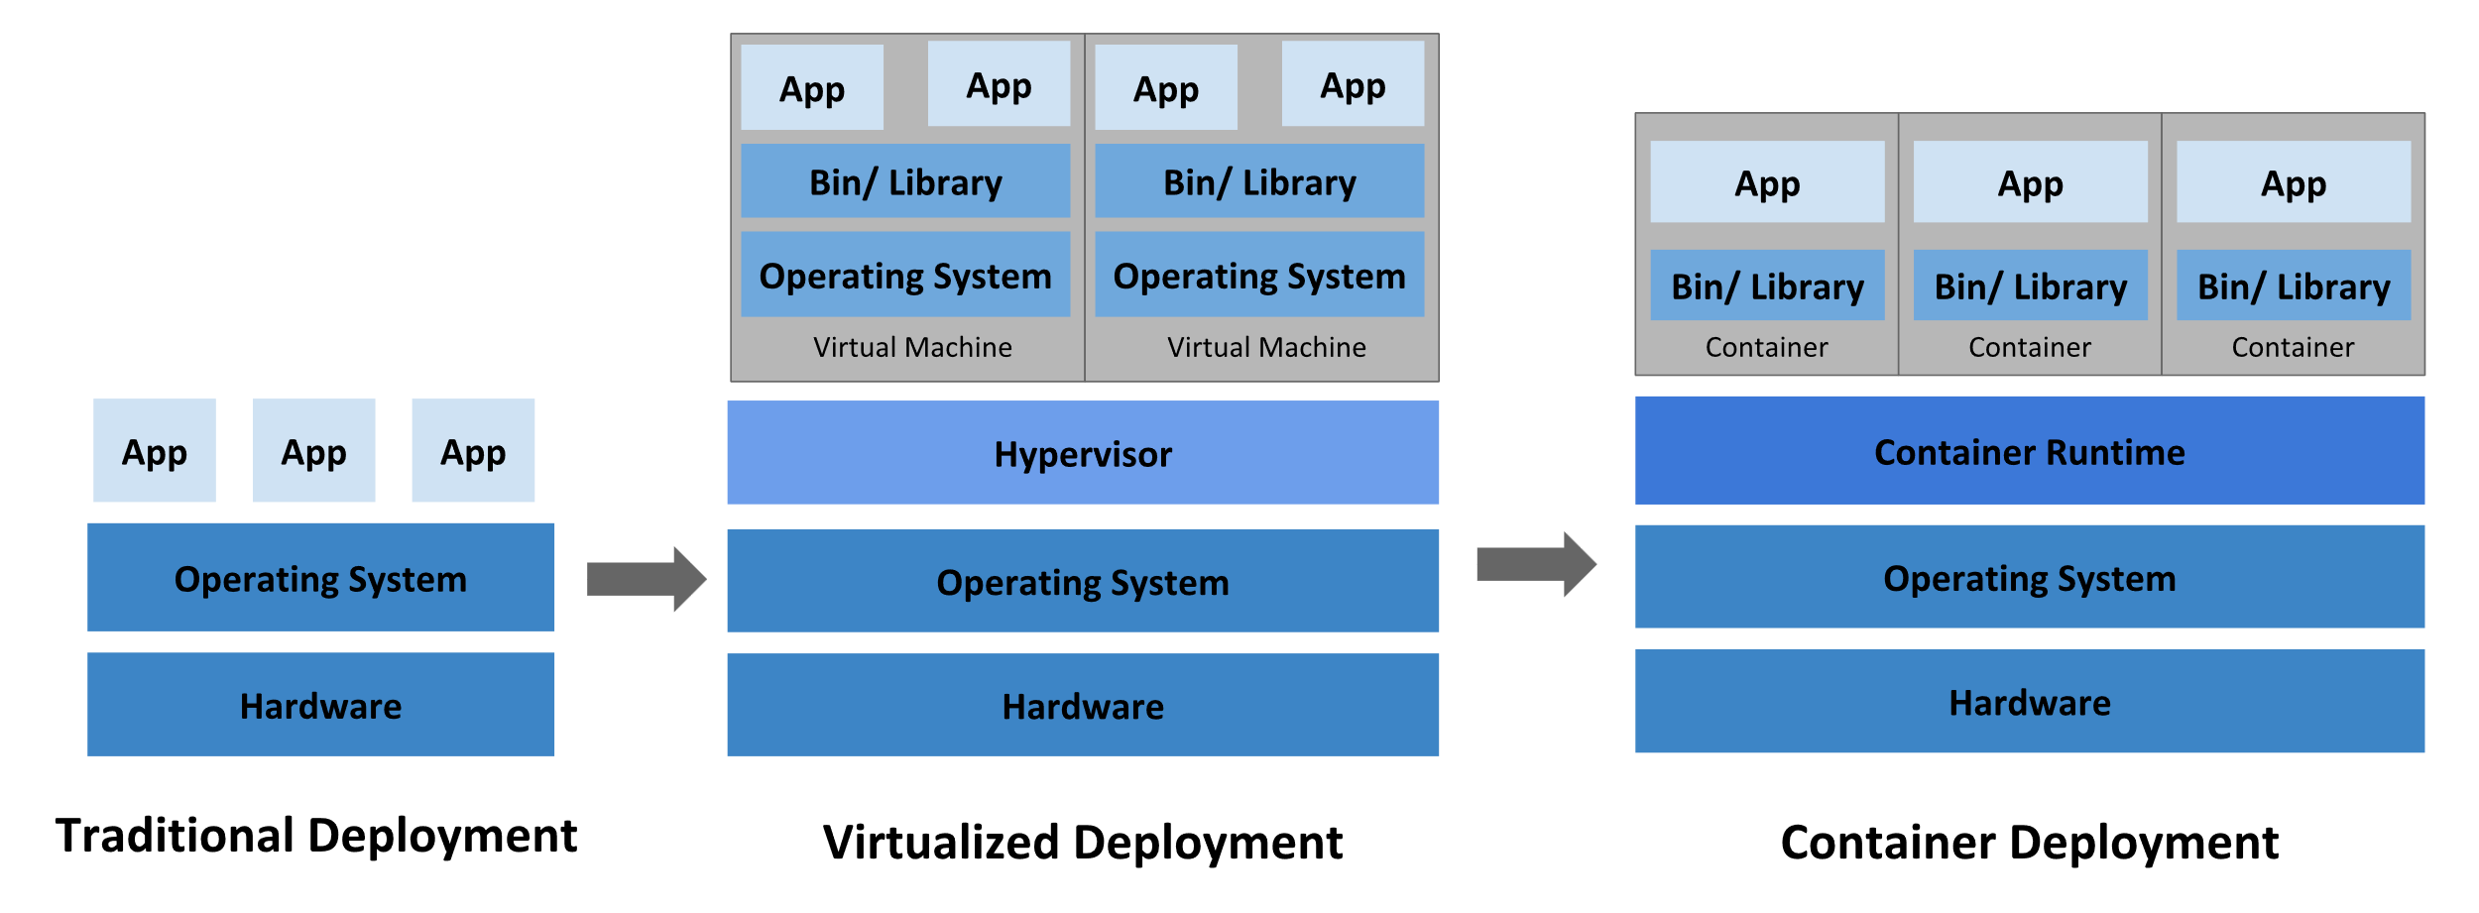
History

Slide 3
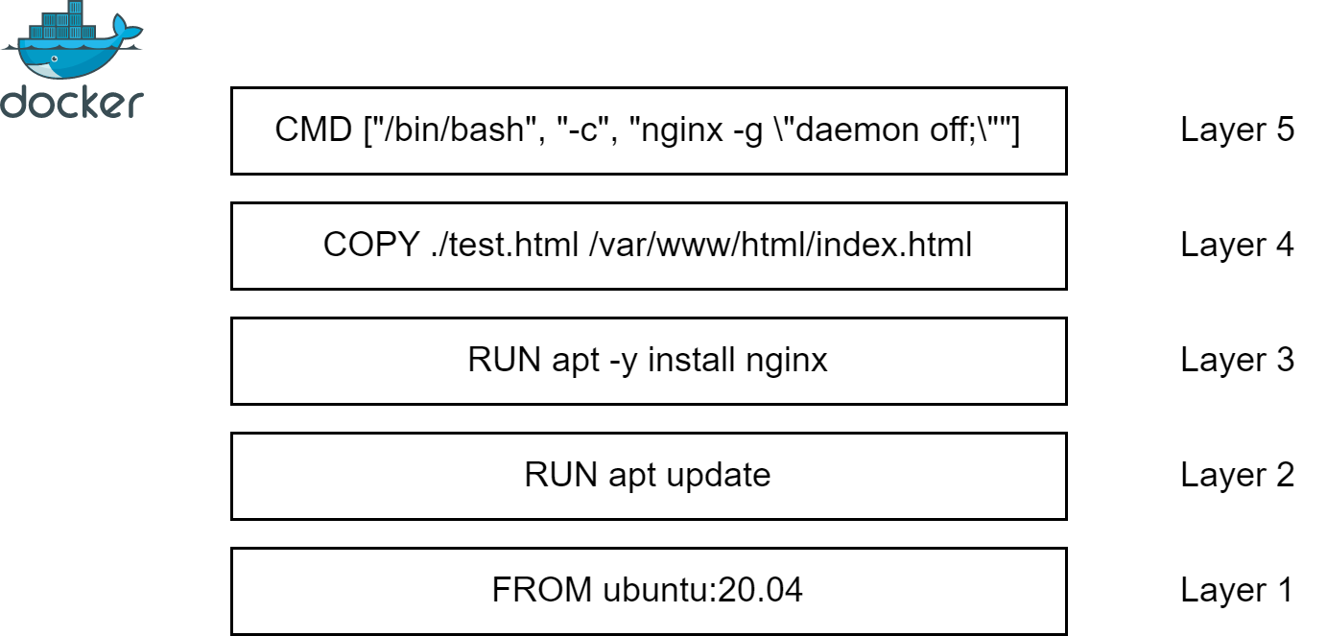
Docker Containers
WHY do we need this?
To simplify deployment process and increase resource utilization.

Slide 4
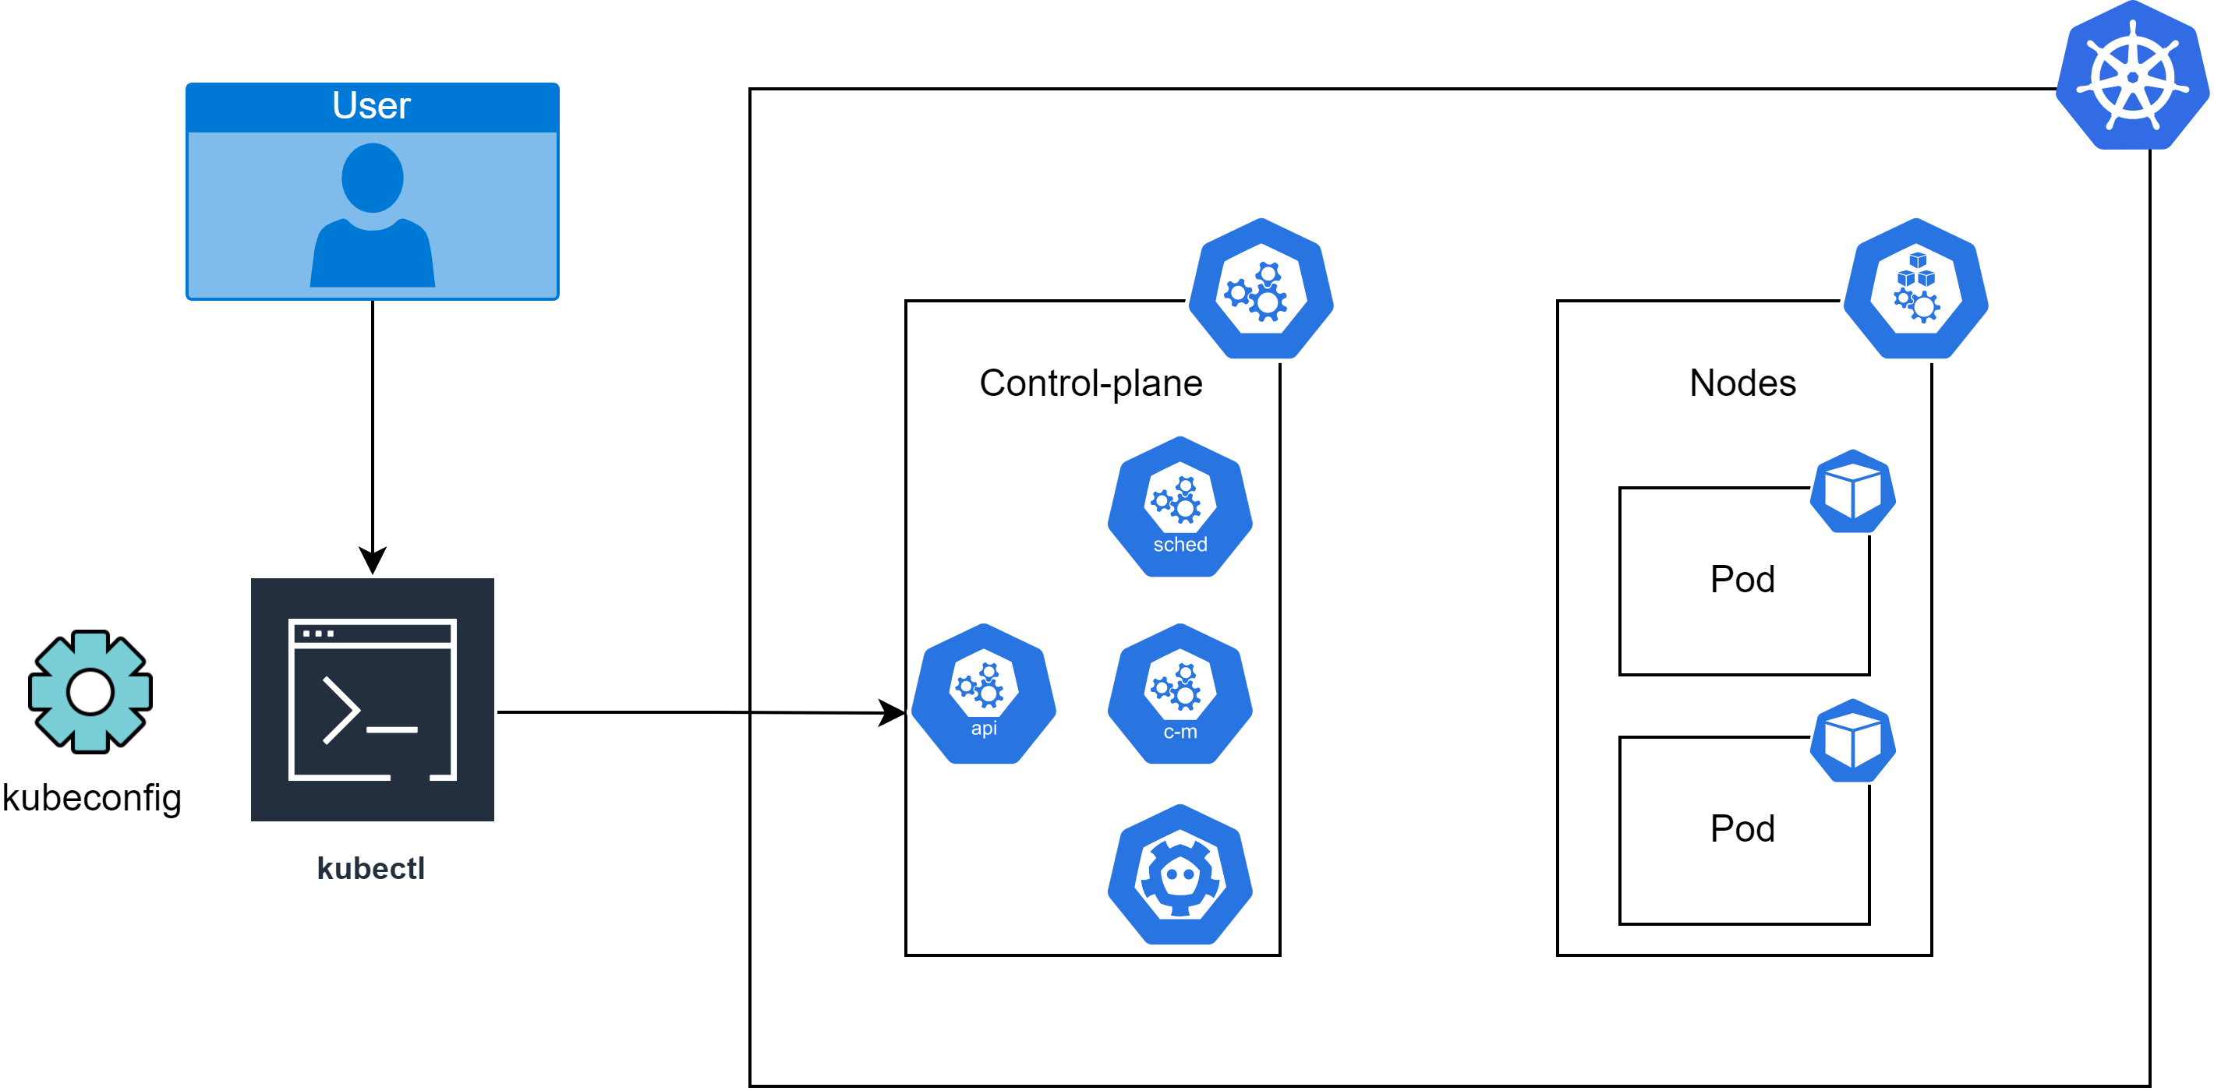
Kubectl
WHY do we need this?
To be able to deploy resources to cluster.
Scheduler - schedules pods
API server aka
“control-plane frontend”
ETCD aka
“cluster distributed backup storage”
Controller-manager aka
“cluster internal processes manager”

Slide 5
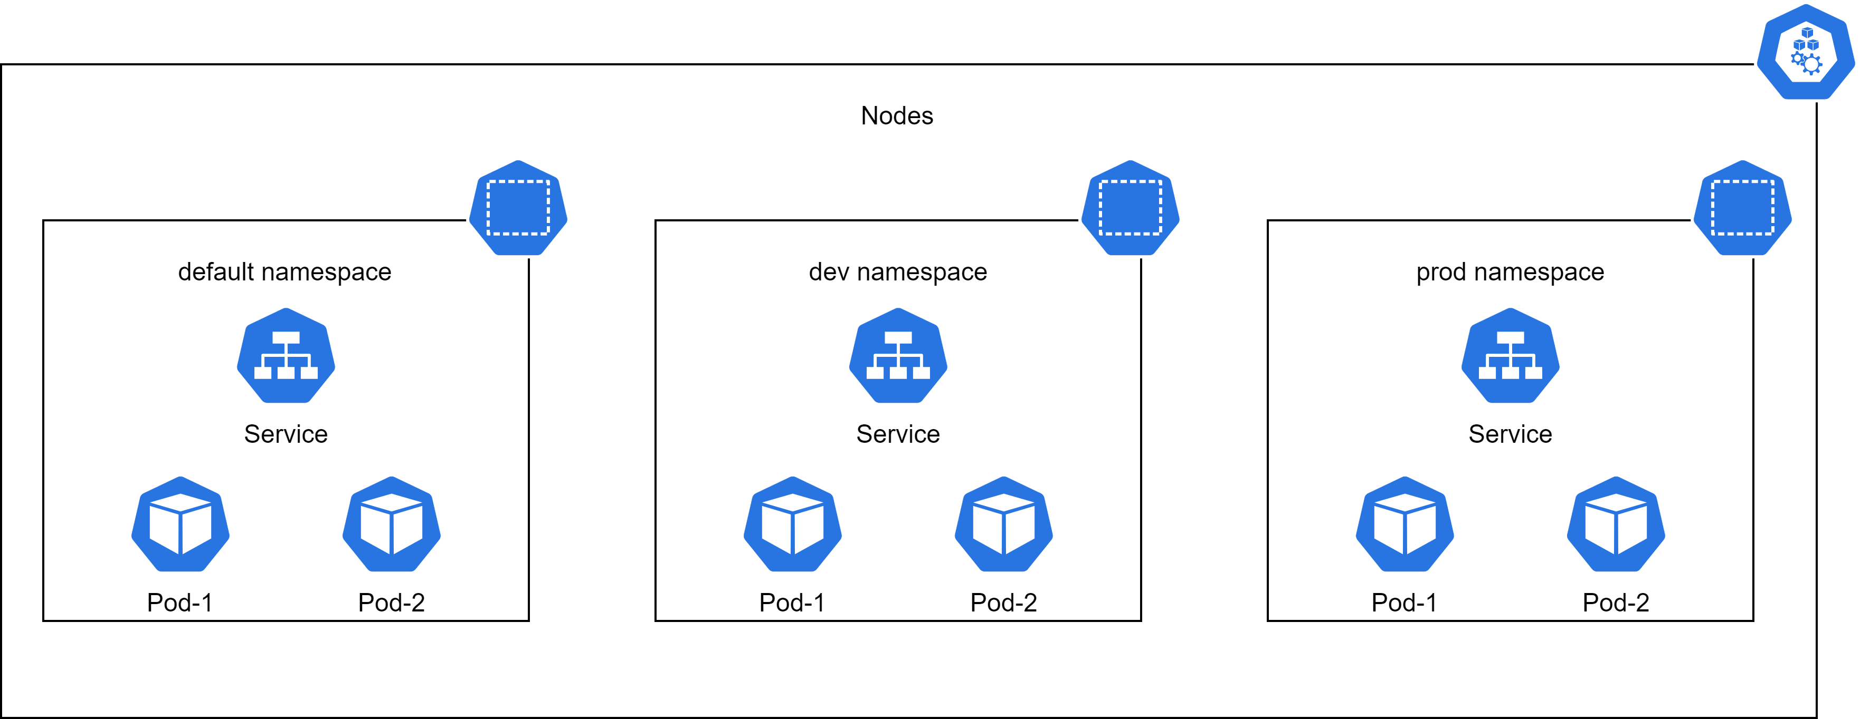
Nodes and Namespaces
WHY do we need this?
Nodes – to run docker containers, Namespaces - to simplify resource management, like folders for files.

Slide 6
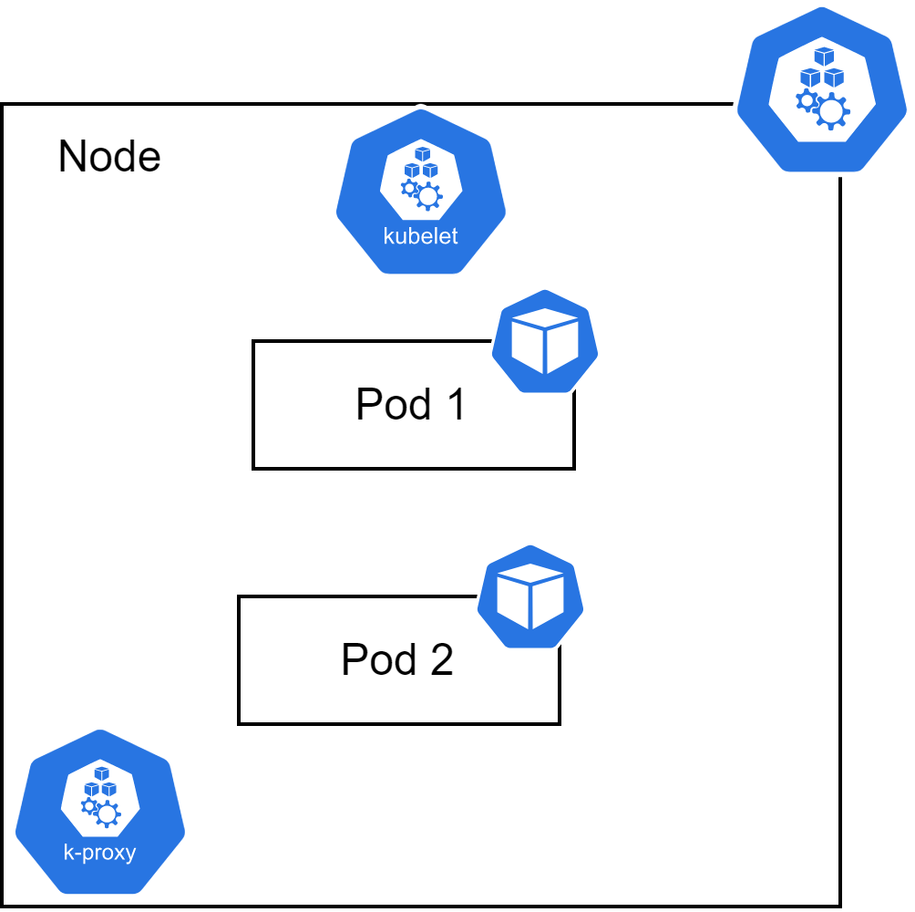
Pods
WHY do we need this?
To configure and run docker container in an efficient way.

Slide 7
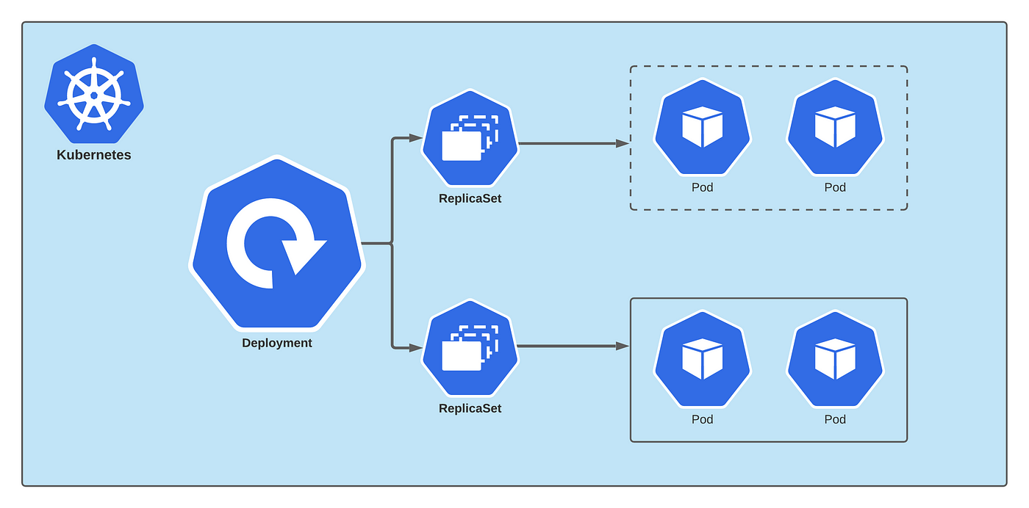
Deployment
WHY do we need this?
To make pods scalable and fault-tolerant.

Slide 8
Deployment Affinity
WHY do we need this?
To manage scheduling process for pods.
Affinities
Node
Pod
Affinities
Affinities
Affinity
AntiAffinity
Required
Preferred

Slide 9
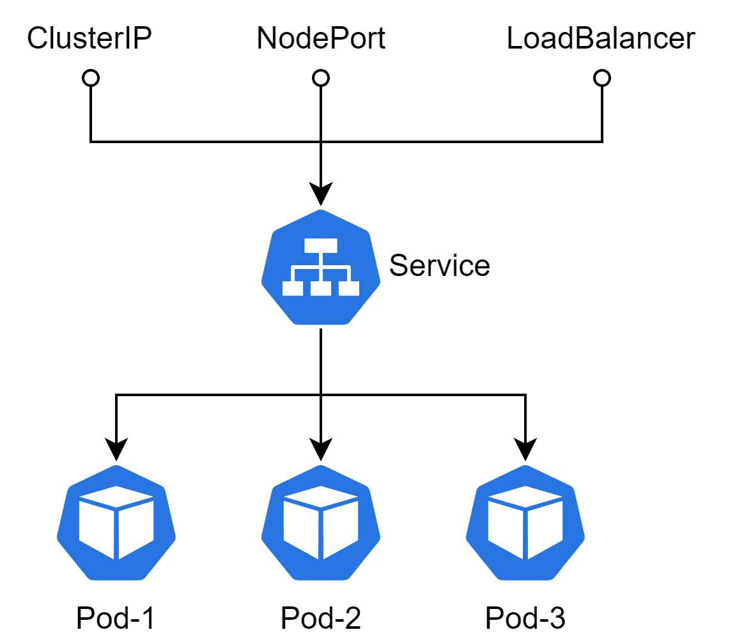
Service
WHY do we need this?
To loadbalance traffic across pods.

Slide 10
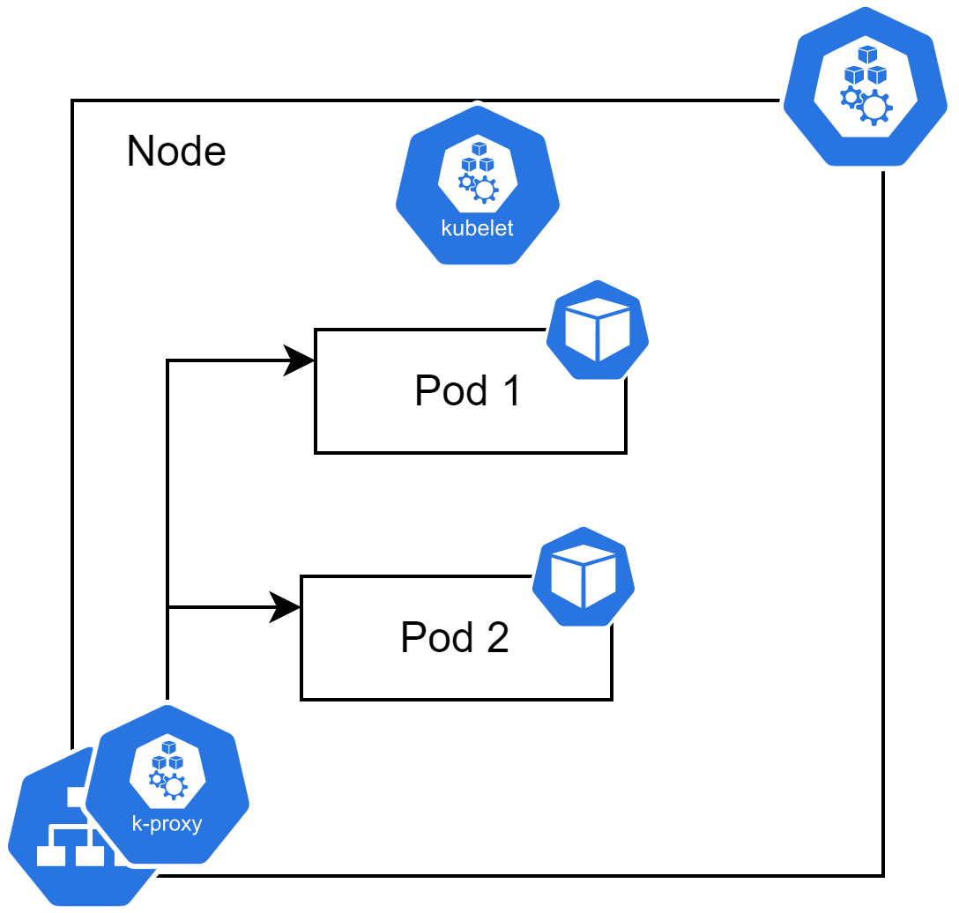
Service high level
WHY do we need this?
To understand how it works in reality.

Slide 11
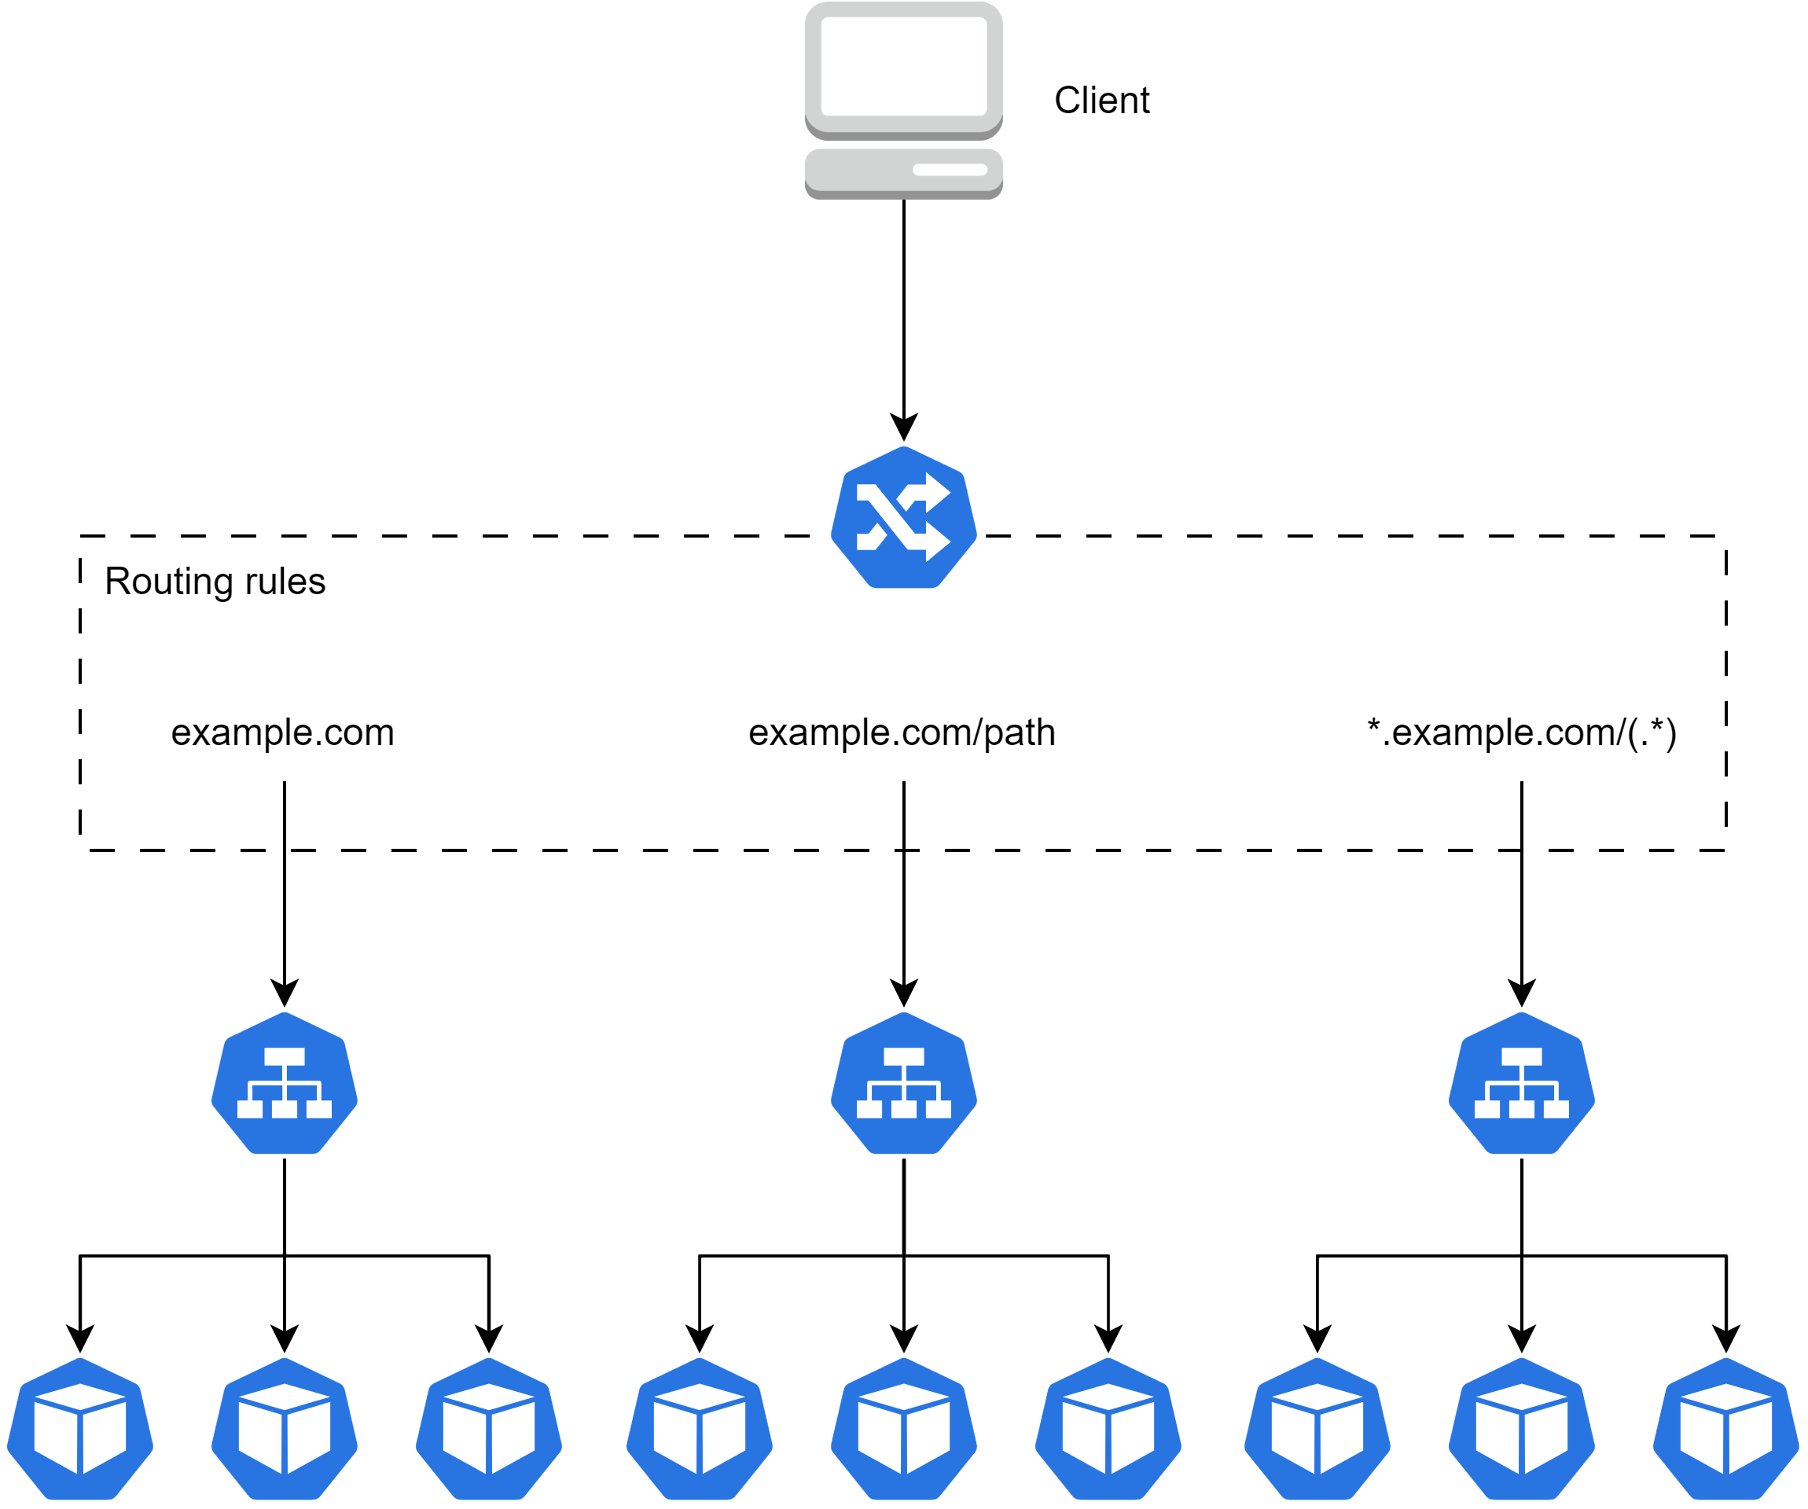
Ingress
WHY do we need this?
To expose service to otter world.

Slide 12
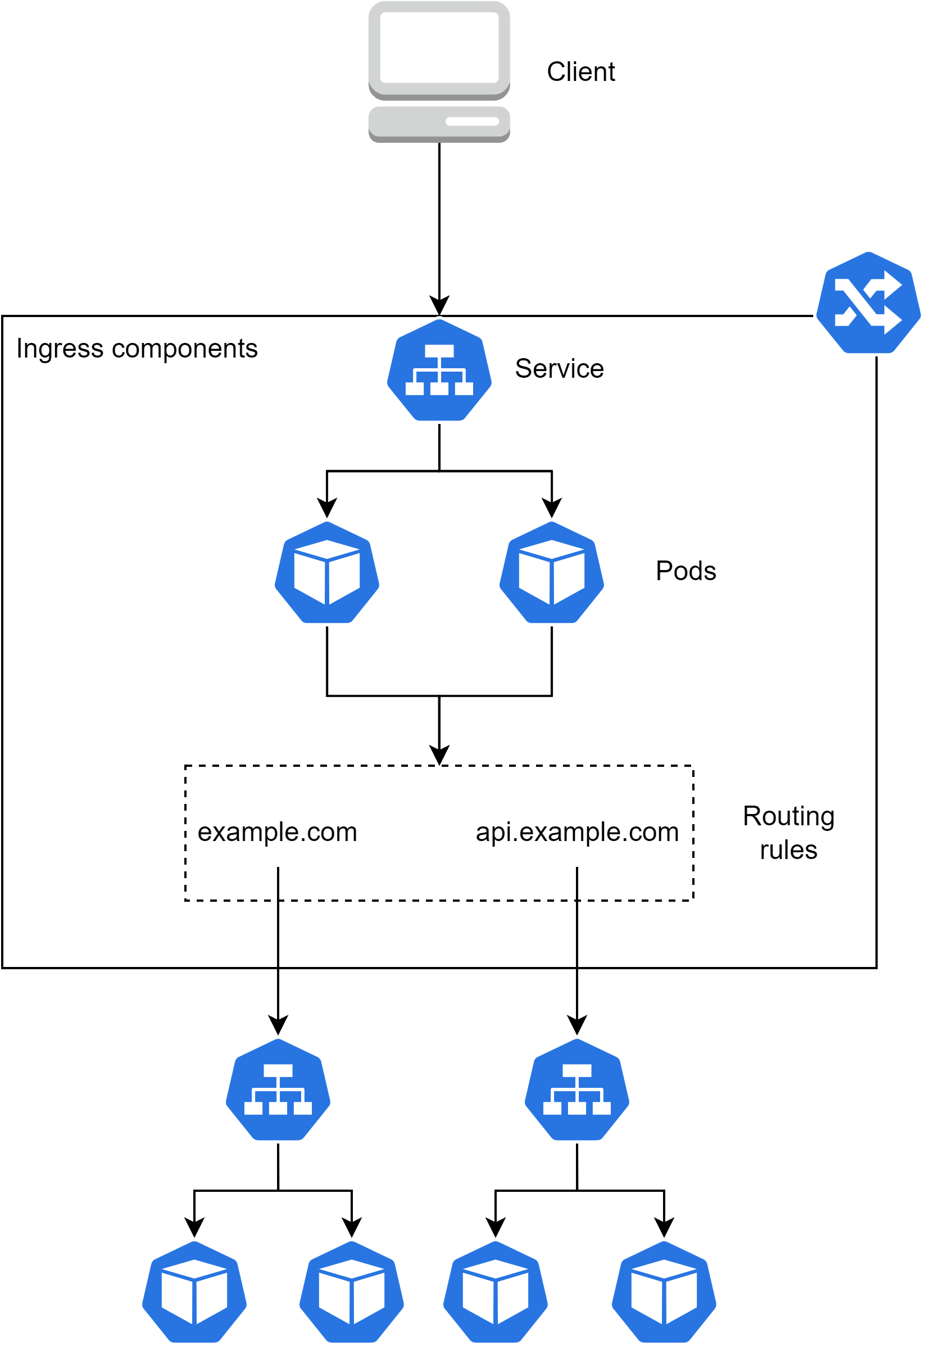
Ingress high level
WHY do we need this?
To understand how it works in reality.

